Slide 1




Optimal Energy Procurement for Geo-distributed Data Centers in Multi-timescale Markets
IFIP WG 7.3 Performance 2017
New York, USA - Nov. 16
Tan N. Le, Jie Liang, Zhenhua Liu,
Ramesh K. Sitaraman, Jayakrishnan Nair, and Bong Jun Choi
tan.le@stonybrook.edu

Slide 2
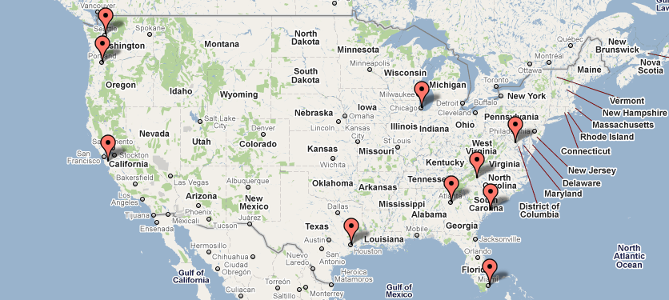
Geographical Load Balancing (GLB)
Google data center
sources
Minimize network delay
Increase reliability
Load balancing
Network latency
Energy
All are time varying and location dependent
Notes:
Nowadays, internet services are usually provided by internet-scale systems.
For example, Google has data centers across the United States to minimize network delay, and increase reliability.

Slide 3

Energy procurement in multi-timescale markets
2 data centers in TX & NY:
TX: $0.03 kWh (long-term) & $? kWh (real-time)
NY: $0.05 kWh (long-term) & $? kWh (real-time)
In real-time, renewables & demand are uncertain
→ Over or under procurement
→ expensive
Time
Long-term
Real-time
How much electricity should we purchase in long-term for each data center?
Notes:
Another focus of our work is multi-timescale markets.
For example, long term market and real-time market. Long-term market is the market that people can purchase the electricity ahead of time via forward contracts.

Slide 4

Challenges raise on the energy procurement problem
kW
$/MWh
Mbps
hours
hours
hours
wind generation in CA
(NREL)
electricity prices
(CAISO)
workload in CA (Akamai)
Long-term procurement and real-time GLB are coupled
Real-time costs depend on what happens in long-term Long-term decision needs to consider how GLB works
Notes:
In real-time, people assume that we know all the information to do GLB. However, there are still many uncertainty sources when we are at long-term market
For example, wind generation in a week in CA
Electricity prices
And especially workload

Slide 5
Prior works
Real-time markets
Locational prices:
“Cutting the electric bill for internet-scale systems” SIGCOMM’09
A. Qureshi, R. Weber, H. Balakrishnan, J. Guttag, B. Maggs
“Greening geographical load balancing” SIGMETRICS’11
Z. Liu, M. Lin, A. Wierman, S. H. Low, and L. L. Andrew
Temporal prices:
“Minimizing data center SLA violations and power consumption via hybrid resource provisioning” IGCC’11
A. Gandhi, Y. Chen, D. Gmach, M. Arlitt, M. Marwah
Multi-time scale markets
“Energy portfolio optimization of data centers” Trans. Smartgrid’16
M. Ghamkhari, A. Wierman, and H. Mohsenian-Rad

Slide 6
Energy Procurement System
Long-term Forecaster
Renewables
workload demand
Forecasted
Information
Energy Procurement (EP)
Geographical Load Balancing
(GLB)
Long-term
procurement
Load balancing
Long-term procurement
Real-time procurement
Long-term markets
Real-time markets
t = -T_{l}
t = 0
Time t
Notes:
The two-time scale markets can be extended into multi-timescale markets

Slide 7
Goal: Optimize procurement in long-term markets
Challenges: Deal with multiple sources of uncertainty
Prediction
Modeling
Algorithms
Evaluation
Notes:
Let me present the predictability analysis on the real-data traces.

Slide 8
Long-term forecast
AR (Autoregressive model)
captures daily pattern
input: historical data
SVM (Support Vector Machine)
captures seasonality of data
input: hour, day, month
L-AVG (Long-term Average) as a baseline
assumes data have long-term cycles
i.e., average of 30 days at the same time of previous years
Notes:
Long-term prediction itself is challenging, we do not try to propose any methods that work well with well in long-term range.
We first use AR to capture the daily pattern of data. The data can may have clear daily pattern like PV generation.
We use SVM to captures the seasonality of data. It is believed that the output may vary according 4 seasons in a year.
Long-term AVG is used as a baseline.

Slide 9
Heterogonous prediction errors based on location
AR
L-AVG
SVM
Wind generation
(30-day ahead)
Electricity prices
(30-day ahead)
workload
(1-day ahead)
We use AR for the other results in this talk
Notes:
Wind generation: it is hard for AR & SVM to beat L-AVG
Electricity prices: errors are smaller.
Workload: AR shows better performance.
MA may not be helpful.

Slide 10
Error distributions are not Normal
TX
CA
NY
Probability density
Probability density
Probability density
Prediction error (%)
Prediction error (%)
Prediction error (%)
Wind generation
Electricity prices
Workload
Notes:
These 3 figures are error distributions of Wind generation, electricity prices and workload.
They are asymmetric and non of them looks like Normal distribution.
Furthermore, they have different shapes which we cannot assume all of them using the same distribution functions.

Slide 11
Goal: Optimize procurement in long-term markets
Challenges: Deal with multiple sources of uncertainty
Prediction
Modeling
Algorithms
Evaluation
Notes:
Let me present the predictability analysis on the real-data traces.

Slide 12
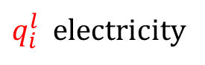
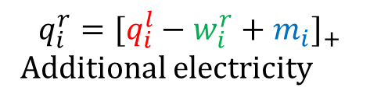
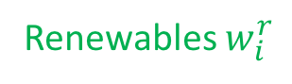
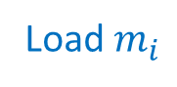
Model: GLB in Multi-timescale Markets
J demand sources
Renewables $w_{i}^{r}$
Load $m_{i}$
$q_{i}^{l}$ electricity
$$q_{i}^{r}={[q_{i}^{l}−w_{i}^{r}+m_{i}]}_{+}$$
Additional electricity
N geo-distributed data centers
How to optimally purchase the electricity in long-term markets?
Notes:
Lets take a look at the system model.
There are J demand sources and N data centers. Sources and data centers are all connected.
In a data center I, it has electricity demand m_i and renewables w_i
A data center participates in two-timescale markets. Each data center purchase q_i at long-term market and additional electricity if needed in real-time.

Slide 13
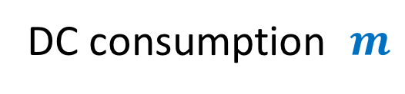
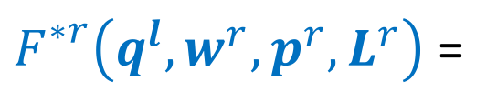
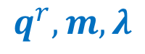
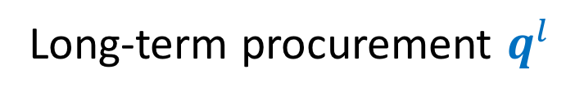


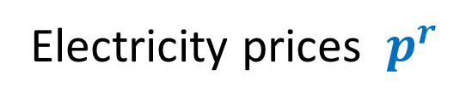
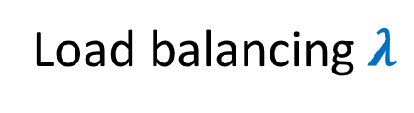

Real-time geographical load balancing
$F_{}^{∗r}\left({q^{l},w}^{r},{p^{r},L}^{r}\right)$ =
Minimize energy costs + delay costs
$$q^{r},m, λ$$
input
output
Long-term procurement $q^{l}$
Load balancing$λ$
Demand $L$
Procurement $q^{r}$
Electricity prices $p^{r}$
DC consumption $m$
Renewable energy $w$
Notes:
When the data centers are in real-time market, they do geographical load balancing to minimize the total cost that includes electricity costs and delay costs.
In real-time, there are no uncertainty.

Slide 14
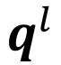
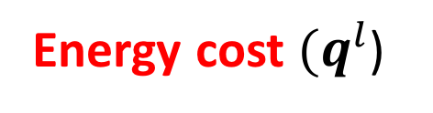
Long-term optimization
Minimize long-term cost + expected optimal real-time cost
$$q^{l}$$
Long-term
Real-time
Energy cost $(q^{l}$)
$$𝔼_{{q^{l},w}^{r},{p^{r},L}^{r}}\left[\text{optimal} \text{real}\text{−}\text{time} \text{cost} \right]$$
$F\left(q^{l}\right)$ = $\sum_{\left\{i∈N\right\}}{R_{i}^{l}\left(q_{i}^{l}\right)} + { 𝔼}_{{q^{l},w}^{r},{p^{r},L}^{r}}\left[F_{}^{∗r}\left({q^{l},w}^{r},{p^{r},L}^{r}\right)\right]$
Notes:
In long-term market, it needs to consider the energy cost in long-term and the cost in real-time.
In long-term, all demand, renewables, prices are random variables and obvious the optimal solution of GLB in real-time is uncertain.
We minimizes the energy cost in long-term as well as the expect optimal real-time cost.
In Math, we define F = ….
People may worry this optimization is so complicated to solve.

Slide 15
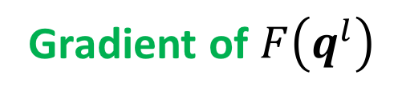
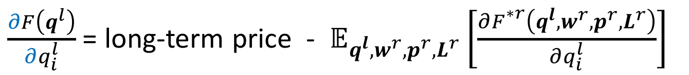
Properties
Convexity of long-term optimal
The long-term objective $F\left(q^{l}\right)$ is convex w.r.t. $q^{l}$
Gradient of $F\left(q^{l}\right)$
$\frac{∂F\left(q^{l}\right)}{∂q_{i}^{l}}$ = long-term price - $𝔼_{{q^{l},w}^{r},{p^{r},L}^{r}}\left[\frac{∂F_{}^{∗r}\left({q^{l},w}^{r},{p^{r},L}^{r}\right)}{∂q_{i}^{l}}\right]$
Full utilization of long-term procurement
Sparsity of routing
There exists an optimal solution with at most $N+J−1$ flows of traffic
Notes:
The long-term optimization looks complicated because of multiple sources of uncertainty and includes the real-time optimization.

Slide 16
Goal: Optimize procurement in long-term markets
Challenges: Deal with multiple sources of uncertainty
Prediction
Long-term Forecaster
Modeling
Energy Procurement
Geographical Load Balancing
Algorithms
Evaluation
Notes:
Let me present the predictability analysis on the real-data traces.

Slide 17



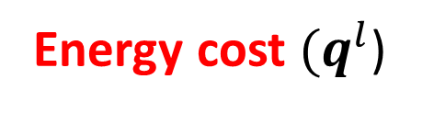
Prediction based Algorithm (PA)
Obtain the predicted values in real-time
Demand
Renewable generation
Electricity prices
$${\hat{L}}^{r}$$
$${\hat{w}}^{r}$$
$${\hat{p}}^{r}$$
Long-term
Real-time
$$𝔼_{{q^{l},w}^{r},{p^{r},L}^{r}}\left[\text{optimal} \text{real}\text{−}\text{time} \text{cost} \right]$$
Energy cost $(q^{l}$)
$$\text{optimal} \text{real}\text{−}\text{time} \text{cost}$$
Notes:
Actually there is a better way to do this.

Slide 18

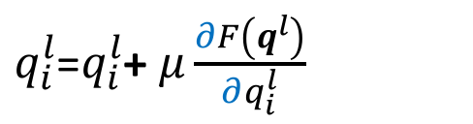
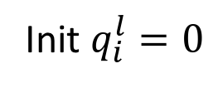
Stochastic Gradient based Algorithm (SGA)
Long-term Forecaster
Init $q_{i}^{l}=0$
Error distributions
$$q_{i}^{l}$$
Energy Procurement
Geographical Load Balancing
prices
Optimal purchase
$q_{i}^{l}$=$q_{i}^{l}$+ $μ\frac{∂F\left(q^{l}\right)}{∂q_{i}^{l}}$
Long-term markets
Theorem. The solution of SGA converges to the set of optimal solutions
Notes:
loop

Slide 19
Goal: Optimize procurement in long-term markets
Challenges: Deal with multiple sources of uncertainty
Prediction
Modeling
Algorithms
Evaluation
Notes:
Let me present the predictability analysis on the real-data traces.

Slide 20



Evaluation Setup
wind power
grid power
Workload: Akamai data in USA
10 data centers
(Google Data Center Map)
Electricity prices from local RTOs
Prediction errors from long-term forecaster
Network delay is proportional to the distance between sources and data centers
Queuing delay M/GI/1
Notes:
Add some reasons & sensitivity analysis.

Slide 21
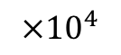
SGA quickly converges
$$×{10}^{4}$$
1.45
1.4
1.35
hourly cost (USD)
1.3
SGA converges quickly
1.25
1.2
50
100
iterations
step sizes are decreasing & dynamic
Notes:
People may worry that the computation takes a lot of time because of there are many sample paths.

Slide 22
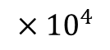
How much do PA & SGA improve?
$$×{10}^{4}$$
Network delay cost
Queueing delay cost
2
Real-time energy cost
Long-term energy cost
1.5
-44%
hourly cost (USD)
1
PA & SGA are very close to OA
0.5
nLTnGLB
fLTnGLB
nLT
fLT
PA
SGA
OA
algorithms
Notes:
Fix the scripts.
Data centers are aggressive in long-term because long-term prices are cheaper than real-time prices & GLB compensation in real-time.

Slide 23
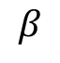
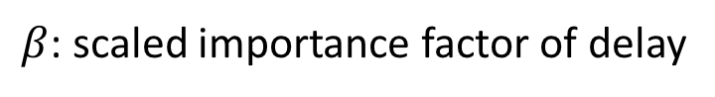
Why does PA work well?
25
PA vs. OA
20
PA vs. SGA
15
PA is worse than SGA & OA
Trade-off between energy and delay facilitates PA
Gap (%)
10
PA is close to SGA & OA
5
0.25
0.5
1
1.5
2
$$β$$
$β$: scaled importance factor of delay
Notes:
Beta=1 equivalent when 100 ms delay cost 1% of revenue.

Slide 24
Sensitivity analysis
Gap (%)
Hourly cost
Hourly cost
Avg. real-time prices/long-term price
distributions
Prediction errors
Notes:
Add more sensitivity analysis
Show that the improvement is consistent.
GEV: generalized extreme value

Slide 25
Goal: Optimize procurement in long-term markets
Challenges: Deal with multiple sources of uncertainty
Long-term Forecaster
Energy Procurement
Geographical Load Balancing
tan.le@stonybrook.edu
Notes:
Thank you

Slide 26
Future work
Two-timescale markets
Multi-time scale markets
Single timeslot in real-time
Multiple timeslots
Thank you

Slide 29
Weak correlation on long distances
Correlation coefficient
Correlation coefficient
Correlation coefficient
distance (km)
distance (km)
distance (km)
Wind generation
Electricity prices
Workload
Notes:
These figures show the correction of prediction errors based on the distances between two data sources.
X-axis show the distances while y-axis shows the correlation coefficients
For wind generation prediction errors, the correlation decreasing when the distance become longer. It does not depend on the time zone.
For electricity prices, the correlation depends on both distance and whether they are in the same RTO or not.
For workload, the correlation is mostly weak at long-distances.
Remove this slide…

